Slide 1
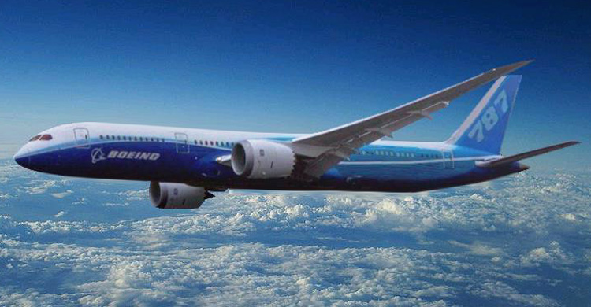
Boeing 787
By: Mathew Potts

Slide 2
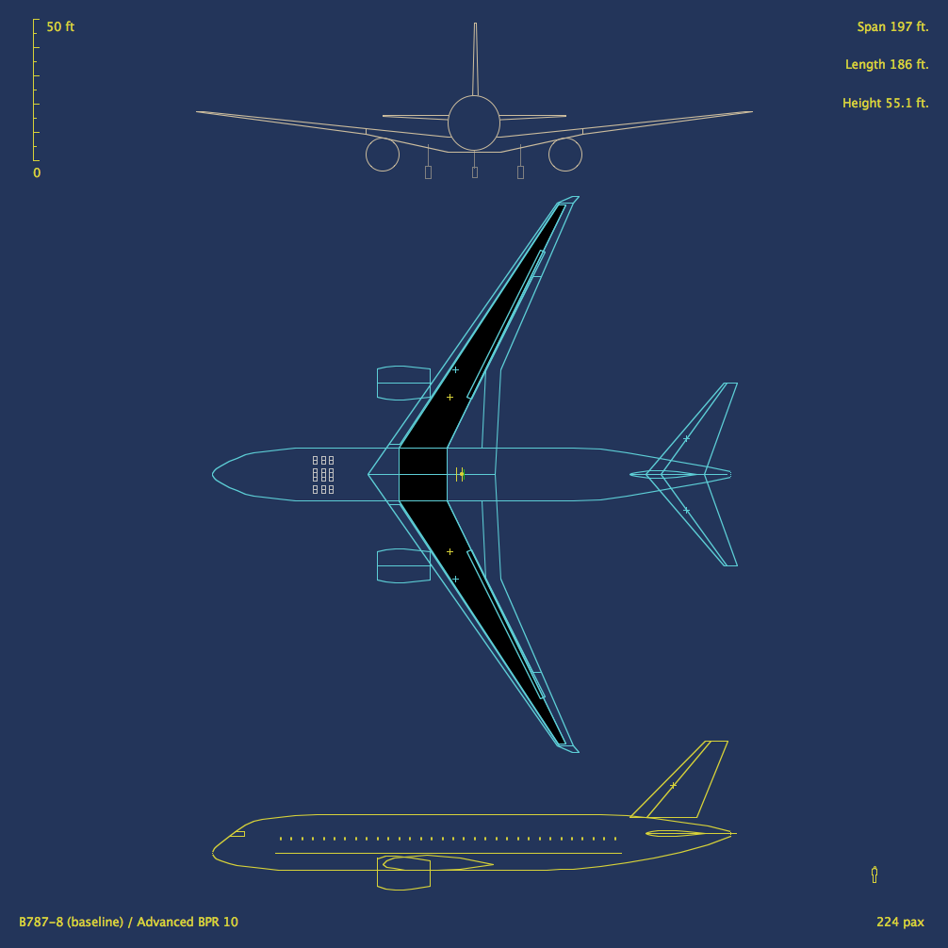
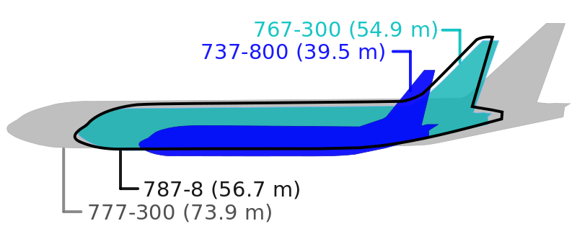
Mission Statement
Boeing states that it is the company's most fuel-efficient airliner and the world's first major airliner to use composite materials for most of its construction.
787 consumes 20% less fuel than the similarly-sized 767.

Slide 3
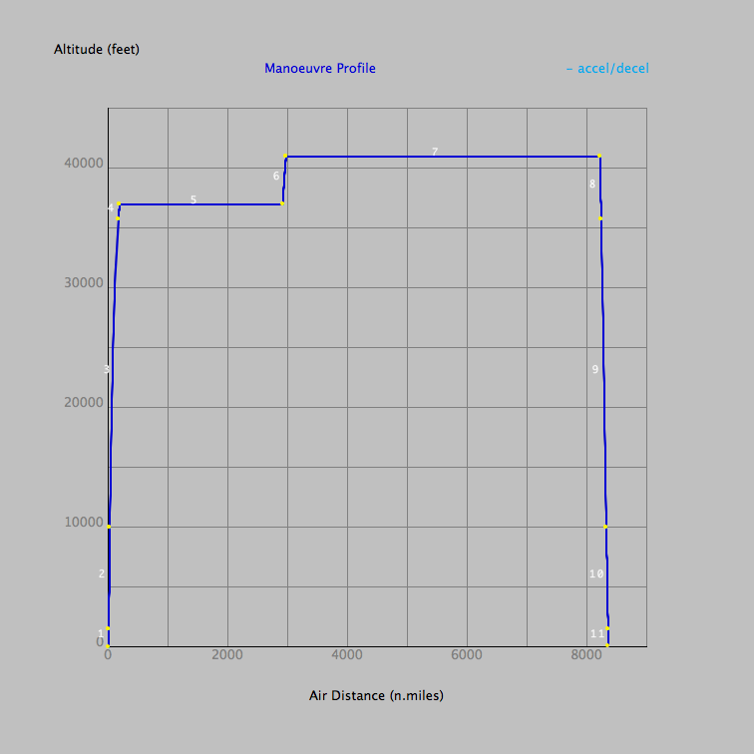

Slide 4
New Materials
Each 787 contains approximately 35 short tons of carbon fiber reinforced plastic, made with 23 tons of carbon fiber.
Higher Strength to Weight Ratio
Composites are used on fuselage, wings, tail, doors, and interior.
Composites - 50%
Aluminum - 20%
Titanium - 15%
Steel - 10%
Other - 5%

Slide 5
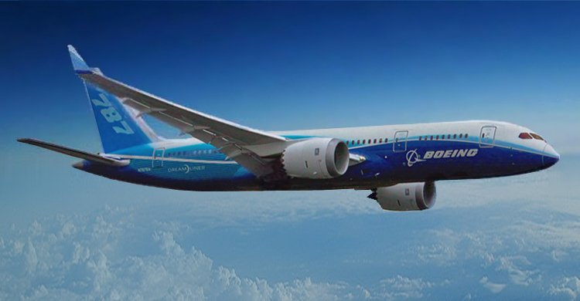
Random Facts
Anticipated maintenance Savings 30 percent
200-300 seats (depending on the model)
Better cash seat mile costs by 10%
20% less emissions
Mach 0.85 about the same as a 777 and 747

Slide 6
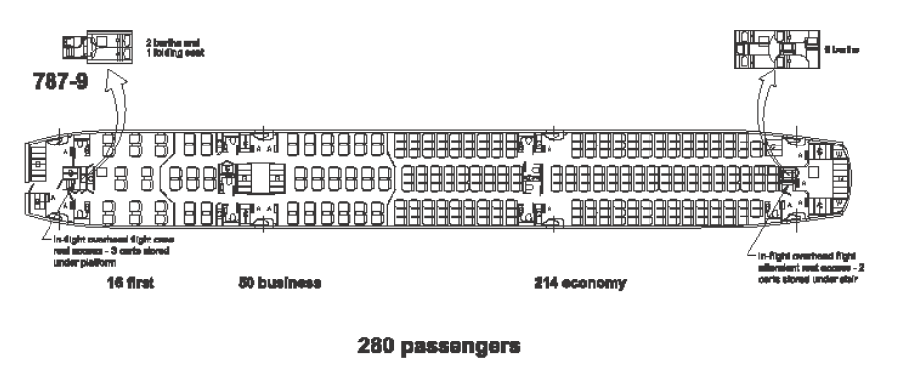
Inside the Dream Liner
http://www.youtube.com/watch?v=TV51KtzLcLo
USB Ports
State of the art entertainment system

Slide 7
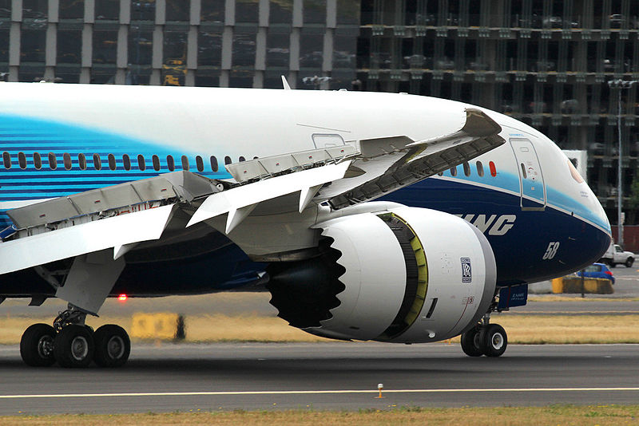
Engines
The 787's engines use all-electrical bleedless systems, eliminating the superheated air conduits normally used for aircraft power
50% less complex
Boeing adopted several engine noise-reducing technologies for the 787.
air inlet containing sound-absorbing materials
redesigned exhaust duct covers whose rims are tipped in a toothed or chevron pattern to allow for quieter mixing of exhaust and outside air.
The two different engine models compatible with the 787 use a standard electrical interface to allow an aircraft to be fitted with either Rolls-Royce or General Electric engines.
Cuts time/costs of changing engines.

Slide 8
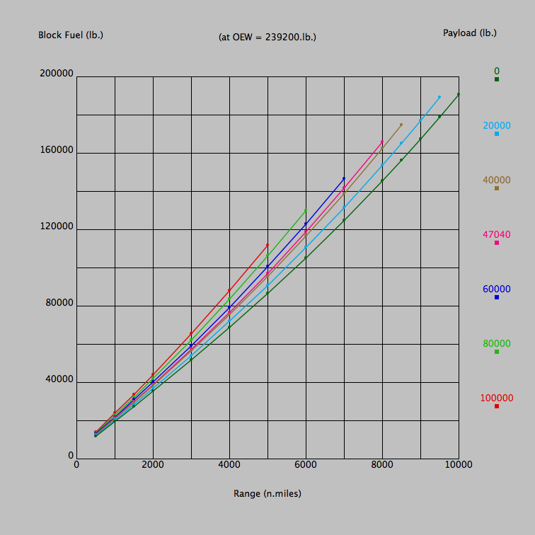
Engine Efficiency

Slide 9
Flight Controls
Another new system is a wing ice protection system that uses electro-thermal heater mats on the wing slats instead of hot bleed air that has been traditionally used.
An active gust alleviation system, similar to the system used on the B-2 bomber, improves ride quality during turbulence.
Airplane's control, navigation, and communication systems are networked with the passenger cabin's in-flight internet systems These included:
air gaps for the physical separation of the networks, and
firewalls for their software separation.
These measures prevent data transfer from the passenger internet system to the maintenance or navigation systems.

Slide 10
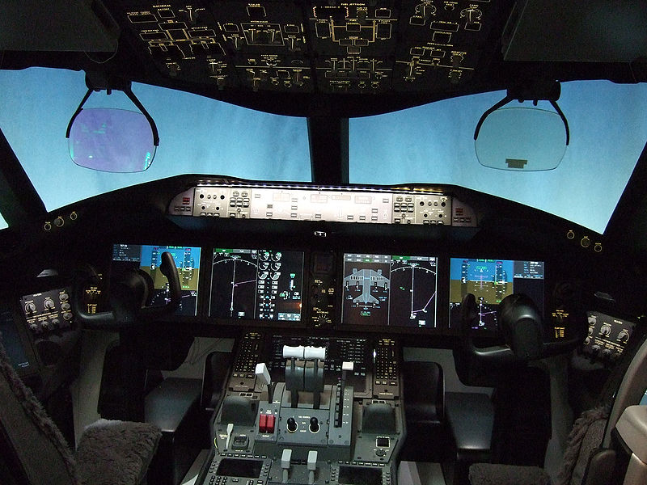
http://www.youtube.com/watch?v=nJJKkZY_7sU&feature=related 1:08-4:00

Slide 11
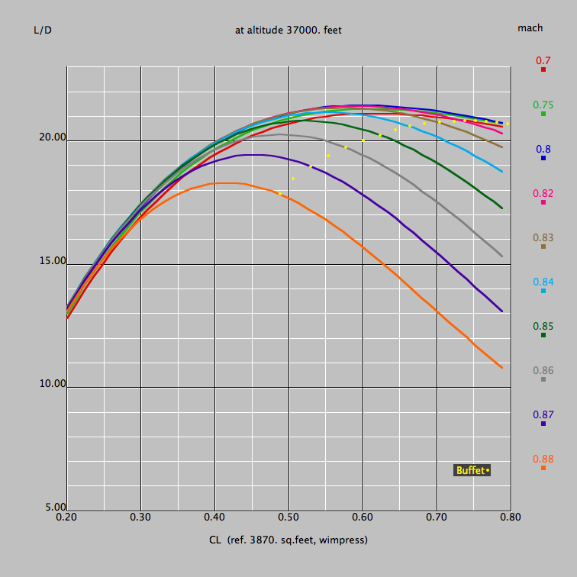
Wing Aerodynamics
MACH 0.850
Altitude (pressure) 37000. feet
KTAS 487.5
KCAS 277.9
Reynolds number 1.873 millions per foot
Aerodynamic Boundaries:
Divergence Mach 0.864 {at the given CL 0.508}
Initial Buffet Mach 0.875 {at the given CL 0.508}

Slide 12
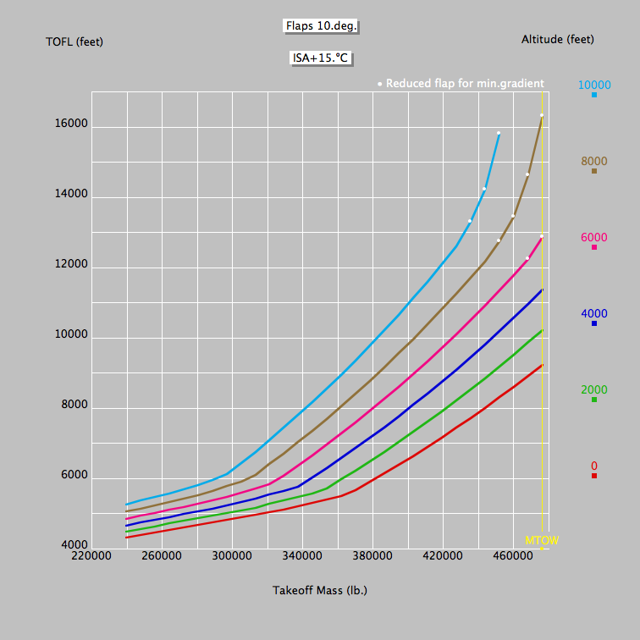
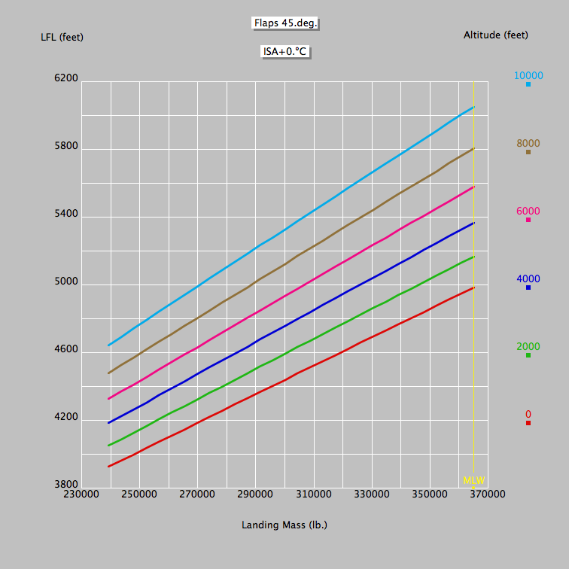
Takeoff Field Length 9255. feet
Takeoff CLmax 1.91
Takeoff Vstall 138. keas
Takeoff Vmc 132. keas
Takeoff Vfail 157. keas
Takeoff V2 165. keas
Landing Distance 2992. feet
Landing CLmax 2.66
Landing Vstall 102. keas
Approach Speed 133. keas

Slide 13
Bibliography
http://en.wikipedia.org/wiki/Boeing_787_Dreamliner
http://www.boeing.com/commercial/aeromagazine/articles/qtr_4_06/AERO_Q406_article4.pdf
http://www.boeing.com/commercial/787family/programfacts.html
http://www.lissys.demon.co.uk/samp1/index.html
http://www.boeing.com/commercial/airports/acaps/787brochure.pdf
http://www.ana.co.jp/cargo/en/int/service/aircraft/b787_8_1.html
http://www.sidchapters.org/pacificnorthwest/meetings/dec14_05_presentation.pdf
http://www.safranmbd.com/IMG/pdf/787LG.pdf

